Slide 1

Operating Systems
School of Computer Engineering and technology

Slide 2
Unit II
Process Management:
Processes: Definition, Process Relationship, Different states of a Process, Process State transitions,
Process Control Block (PCB), Context switching.
Thread: Definition, Various states, Benefits of threads, Types of threads, Concept of multithreading.
l
Process Scheduling:
Foundation and Scheduling objectives, Types of Schedulers, Scheduling criteria:
CPU utilization, Throughput, Turnaround Time, Waiting Time, Response Time. Scheduling
Algorithms: Pre-emptive and non-pre-emptive, FCFS, SIF, RR.

Slide 3

References
1. William Stallings, Operating System: Internals and Design Principles, Prentice Hall, ISBN-10: 0-13-380591-3, ISBN-13: 978-0-13-380591-8, 8th Edition
2. Abraham Silberschatz, Peter Baer Galvin and Greg Gagne, Operating System Concepts, WILEY,ISBN 978-1-118-06333-0, 9th Edition
21/02/19
Operating system
3
Notes:
3
MIT-WPU

Slide 4
Overview
What is a Process?
Process States
Process Description
Process Control
*
Operating systems
4
Notes:
4
MIT-WPU

Slide 5
1. What is a Process
A program in execution
An instance of a program running on a computer
The entity that can be assigned to and executed on a processor
A unit of activity characterized by the execution of a sequence of instructions, a current state, and an associated set of system resources
Process is an entity that consists of two essential elements.
program code (which may be shared with other processes that are executing the same program)
set of data associated with that code.
*
Operating systems
5
Notes:
5
MIT-WPU

Slide 6
Continued..
A process is comprised of:
Program code/instructions
Data
Stack
A number of attributes describing the state of the process.
When a process is mapped on to the memory it has an address space. This address space includes the code , data and stack for the process.
*
Operating systems
6
Notes:
6
MIT-WPU

Slide 7
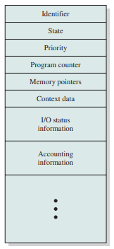
Process Control Block
A process can be uniquely categorized by the following elements, stored in a data structure called as Process Control Block (PCB)
Identifier
State
Priority
Program counter
Memory pointers
Context data
I/O status information
Accounting information
*
Operating systems
7
Notes:
7
MIT-WPU

Slide 8
Operations Carried out through PCB
Process Scheduling: The different information like Process priority, process state, and resources used can be used by the OS to schedule the process on the execution stack. The scheduler checks the priority and other information to set when the process will be executed.
Multitasking: Resource allocation, process scheduling, and process synchronization altogether helps the OS to multitask and run different processes simultaneously.
Context Switching: When context switching happens in the OS the process state is saved in the CPU register and a copy of it is stored in the PCB. When the CPU switches to another process and then switches back to that process the CPU fetches that value from the PCB and restores the previous state of the process.
Resources Sharing: The PCB stores information like the resources that a process is using, such as files open and memory allocated. This information helps the OS to let a new process use the resources which are being used by any other process to execute sharing of the resources.

Slide 9
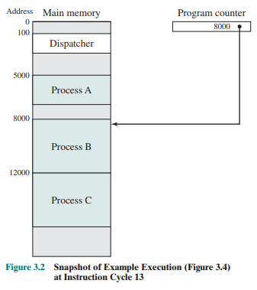
2. Process States (Process Execution)
Figure shows a memory layout of three processes
all three processes are represented by programs that are fully loaded in main memory.
there is a small dispatcher program that switches the processor from one process to another
Notes:
9

Slide 10
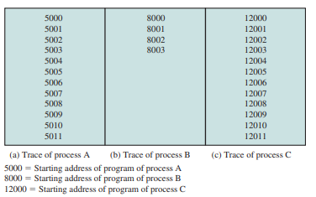
2. Process States(Process Execution )…
Figure shows the traces of each of the processes during the early part of their execution.
The first 12 instructions executed in processes A and C are shown.
Process B executes four instructions, and we assume that the fourth instruction invokes an I/O operation for which the process must wait.
Notes:
10

Slide 11
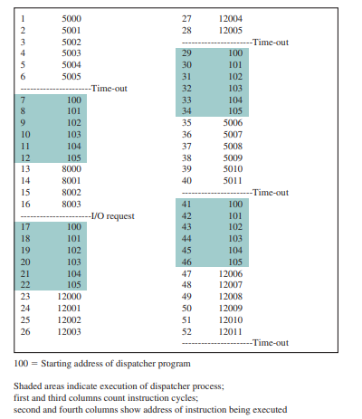
2. Process States(Process Execution )…
Figure shows the interleaved traces resulting from the first 52 instruction cycles
Notes:
11

Slide 12
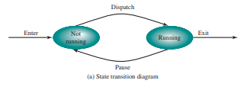
2. Process States(A Two-State Process Model)…
The operating system’s principal responsibility is controlling the execution of processes
determining the interleaving pattern for execution and allocating resources to processes.
a process may be in one of two states: Running or Not Running, as shown in Figure
When the OS creates a new process, it creates a process control block for the process and enters that process into the system in the Not Running state.
Notes:
Animated slide The animation only shows one process moving.
There needs to be some structure so that the OS can keep track of the processes. This could be a simple queue which is managed by the dispatcher routine of the OS.
12

Slide 13
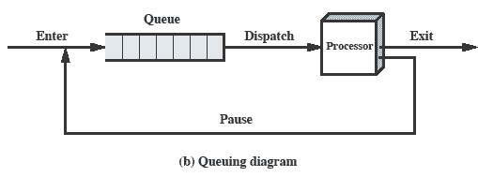
2. Process States(A Two-State Process Model)…
Processes moved by the dispatcher of the OS to the CPU then back to the queue until the task is completed
Processes that are not running must be kept in some sort of queue, waiting their turn to execute.
There is a single queue in which each entry is a pointer to the process control block of a particular process.
the queue may consist of a linked list of data blocks, in which each block represents one process
Notes:
Animated slide The animation only shows one process moving.
There needs to be some structure so that the OS can keep track of the processes. This could be a simple queue which is managed by the dispatcher routine of the OS.
13

Slide 14
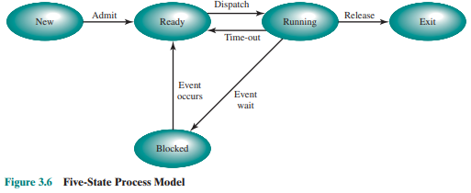
Process Creation(A Five-State Model )
The possible transitions that leads to types of events are as below:
New → Ready
After creation, the process enters the ready queue.
Ready → Running
Scheduler dispatches the process to the CPU.
Running → Blocked
Process requests I/O and must wait.
Blocked → Ready
I/O completes; process is now ready to resume.
Running → Ready
Time slice expires or preemption occurs.
Running → Exit
Process finishes or is forcefully terminated.
*
Operating systems
14
Notes:
14
MIT-WPU

Slide 15
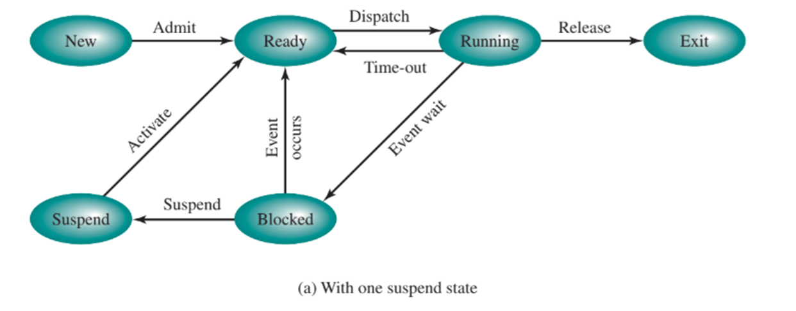
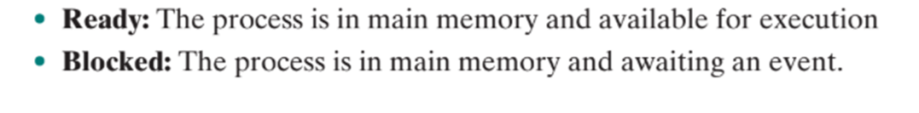
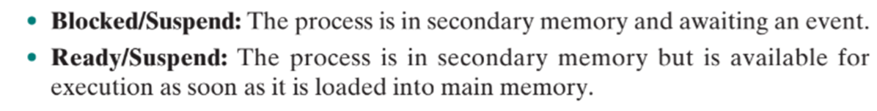
Process Creation(A Seven State Model )
*
Operating systems
15
Notes:
15
MIT-WPU

Slide 16
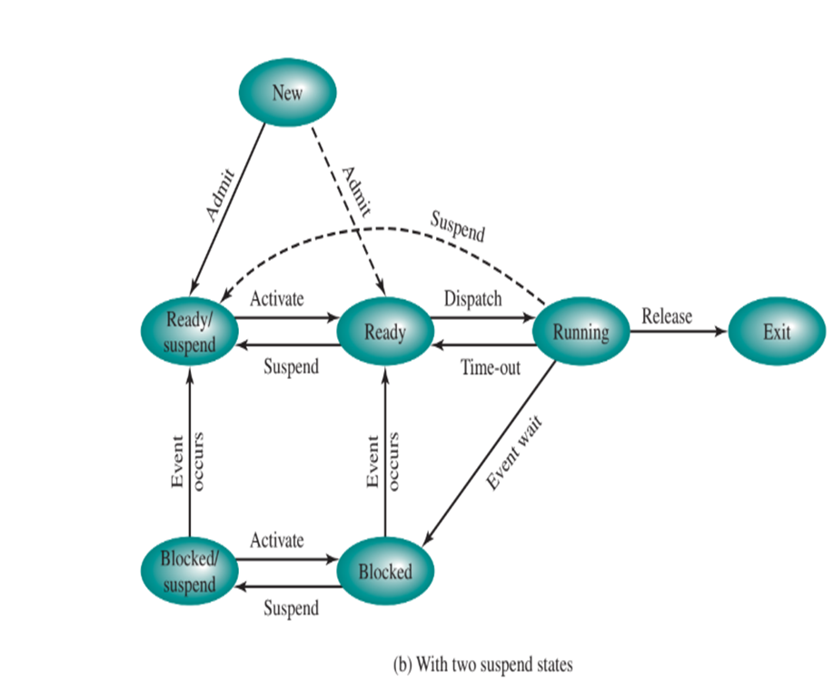
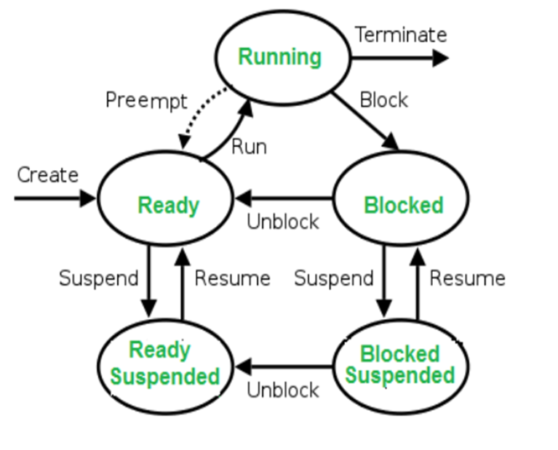
Seven State Model

Slide 17
Different States of a Process
1. New
The process is being created.
Memory, I/O, and PCB are being allocated.
2. Ready
The process is loaded in memory and waiting for CPU allocation.
It is ready to run but waiting its turn on the CPU.
3. Running
The process is actively executing on the CPU.
Only one process can be in the running state per core at a time.
4. Waiting / Blocked
The process cannot proceed until some I/O or event completes.
It waits for external resources like disk, printer, or input.
5. Terminated /Exit
The process has finished execution or was aborted.
OS cleans up resources and removes it from the process table.

Slide 18
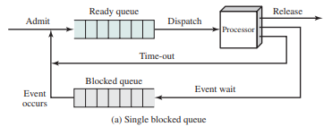
Queueing Model for (A Five-State Model )
When a running process is removed from execution, it is either terminated or placed in the Ready or Blocked queue, depending on the circumstances.
Finally, when an event occurs, any process in the Blocked queue that has been waiting on that event only is moved to the Ready queue.
*
Operating systems
18
Notes:
18
MIT-WPU

Slide 19
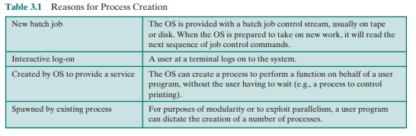
Process Creation
When a new process is created , the following happens :-
1.Allocates space to the process in memory.
2.Assign a unique process ID to the process
3. A Process control block (PCB) gets associated with the process.
4. OS maintains pointers to each process’s PCB in a process table so that it can access the PCB quickly.
5.OS maintains accounting file on each process
When one process spawns another, the former is referred to as the parent process, and the spawned process is referred to as the child process.
*
Operating systems
19
Notes:
19
MIT-WPU

Slide 20
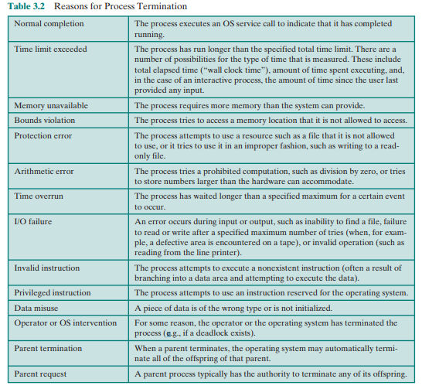
Process Termination
*
Operating systems
20
Notes:
20
MIT-WPU

Slide 21
Process Control
Modes of Execution
Most processors support at least two modes of execution.
Certain instructions can only be executed in the more-privileged mode.
These would include reading or altering a control register, such as the program status word; primitive I/O instructions; and instructions that relate to memory management.
In addition, certain regions of memory can only be accessed in the more-privileged mode.
The less-privileged mode is often referred to as the user mode, because user programs typically would execute in this mode.
The more-privileged mode is referred to as the system mode, control mode, or kernel mode.
*
Operating systems
21
Notes:
21
MIT-WPU

Slide 22
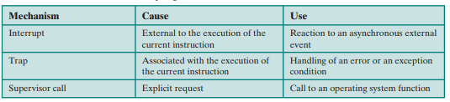
Process Control
Process Switching
A running process is interrupted and the OS assigns another process to the Running state and turns control over to that process
A process switch may occur any time that the OS has gained control from the currently running process
*
Operating systems
22
Notes:
22
MIT-WPU

Slide 23
Process Control
Mode switching
There are two modes of operations :-
Kernel mode ( Privileged mode): It can access its own data-structures as well as
the user mode data structures.
2. User mode : It can access only the user mode data structures.
User programs initially work in the User mode.
Whenever a system call is encountered the control switches to the kernel mode.
All interrupts are serviced in the Kernel mode.
When the system call is serviced the control returns back to the user mode

Slide 24
Process Control(Mode switching)
Kernel mode
User mode
Process A
Process A was executing in User mode and has now switched to the Kernel mode due to some system call. This is mode switch.
As, every context switch is a mode switch, every mode switch may/may not be a context switch.
Process A

Slide 25
Process Control - context switch
For switching of context (environment) from Process A to process B, services of the kernel are needed. The kernel stores the execution environment (context) of process A and retrieves the environment(context) for process B for execution.
Every context switch is a mode switch.
Requires the services of the kernel
Kernel mode
User mode
Process A
Process B

Slide 26
Process Control - context switch
When CPU switches to another process, the system must save the state of the old process and load the saved state for the new process.
Context-switch time is overhead; the system does not do the useful work while switching.

Slide 27
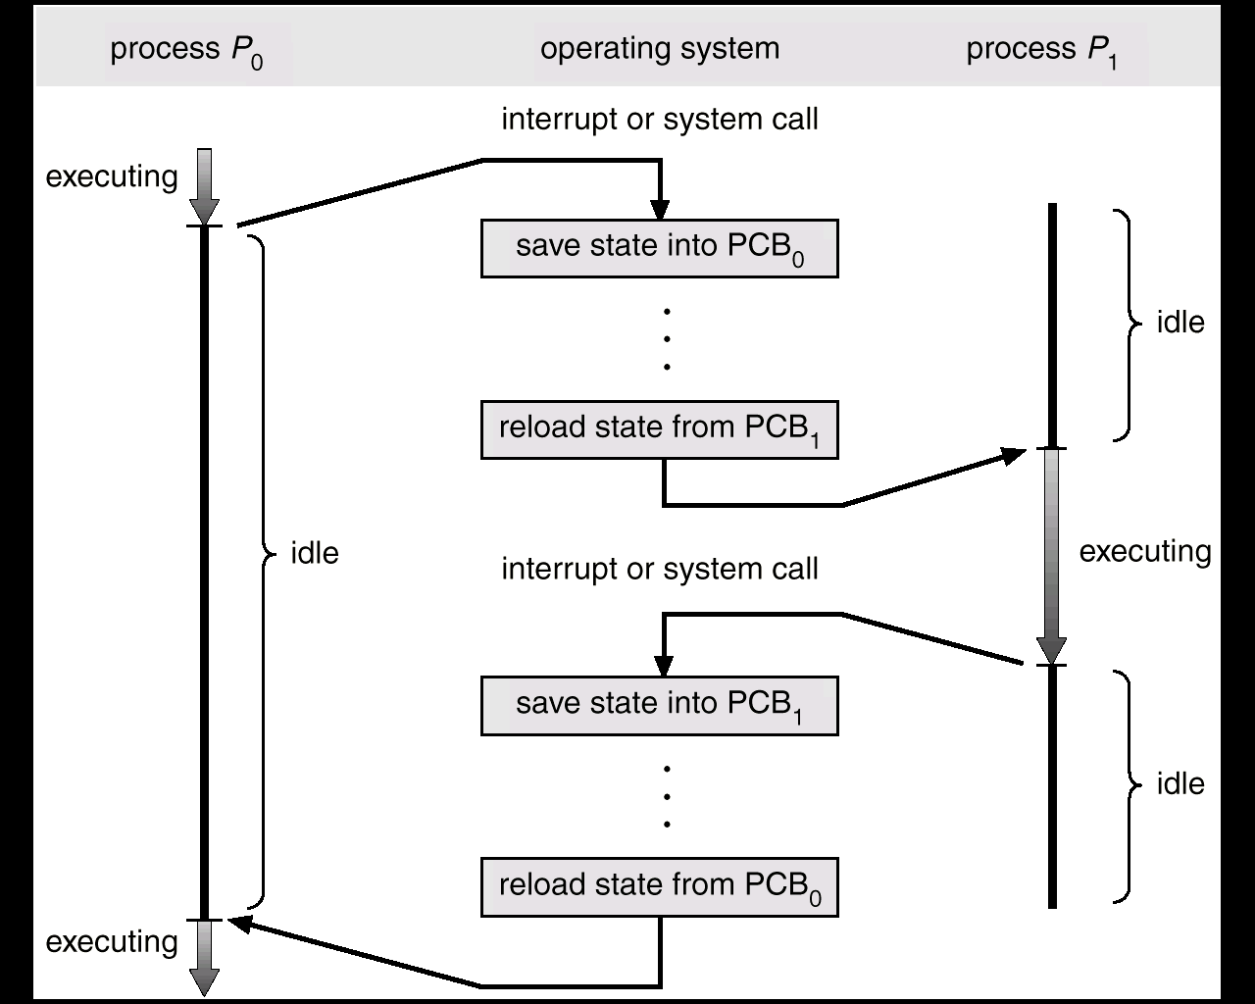
Process Control - context switch
CPU Switch From Process to Process

Slide 28
Process Control
Change of process state
1. Save the context of the processor, including program counter and other registers.
2. Update the process control block of the process that is currently in the Running state. This includes changing the state of the process to one of the other states (Ready; Blocked; Ready/Suspend; or Exit).
3. Move the process control block of this process to the appropriate queue (Ready; Blocked on Event i ; Ready/Suspend).
4. Select another process for execution
5. Update the process control block of the process
6. Update memory management data structures.
7. Restore the context of the processor
*
Operating systems
28
Notes:
28
MIT-WPU

Slide 29
Process Relationships
Parent and Child Processes
Process Tree Structure
Examples:
Init process in Linux
Forking in Unix
Types of Process Relationships
Independent Process
Cooperating Process (shared data, IPC)

Slide 30
Independent Process
A process that does not share data or resources with any other process.
Characteristics:
Cannot affect or be affected by other processes.
No shared memory or communication.
Example:
A calculator app running separately from a text editor.
Cooperating Process
A process that shares data or communicates with other processes.
Characteristics:
Can share data and resources
Requires inter-process communication (IPC)
Common in multitasking systems
Example:
A group of people collaborating on a Google Doc. Each person is a process that reads/writes, and changes are reflected live to others.

Slide 31
Process Creation - Fork
Purpose of fork() is to create a new process, which becomes the child process of the caller.
After a process is created, both processes will execute the next instruction following the fork() system call.
To distinguish the parent from the child, the returned value of fork() can be used:
fork() returns a negative value, the creation of a child process was unsuccessful.
fork() returns a zero to the newly created child process.
fork() returns a positive value, the process ID of the child process to the parent
Returned process ID is of type pid_t defined in sys/types.h
Process can use function getpid() to retrieve the process ID assigned to this process
Unix/Linux will make an exact copy of the parent's address space and give it to the child. Therefore, the parent and child processes have separate address spaces.

Slide 32
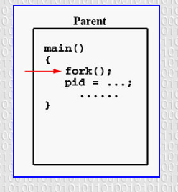
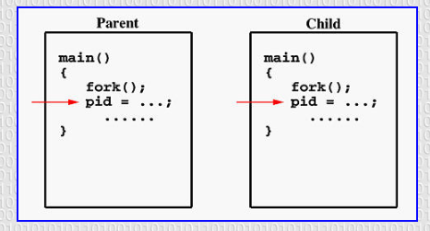

Slide 33
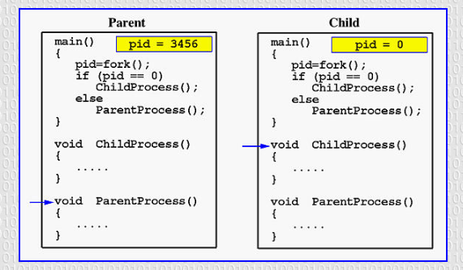

Slide 34
Process Management—creating a Process in Unix(example)
$cc program.c
$ ./a.out
this is the child process id 1001
this is the parent process id 1000
#include<stdio.h>
#include<sys/types.h>
#include<unistd.h>
/* pid_t : is a long integer type data type...prototype in types.h */
pid_t num_pid;
main(){
num_pid=fork(); /* return value of fork */
if(num_pid==0) {/* this is child process */
printf("this is the child process id %d\n",getpid());
}
if(num_pid>0){ /* this is parent process */
printf("this is the parent process id %d",getpid());
}
exit();
}

Slide 35
Process Creation – Parent/Child
Parent Process
The parent process has its unique ID
The parent process creates a child process by giving a call to fork() system call
Child Process
The child process has its unique ID
The child process gets created due to the fork() system call
The child is initially a duplication of the parent process.
The child and parent do exist in separate address spaces.
The child inherits all data structures
A client-server application can be built using the parent-child concept.
Any IPC mechanism can be implemented using the parent child relationship.

Slide 36
fork()
#include <stdio.h>
#include <sys/types.h>
#include <unistd.h>
int main()
{ fork();
printf("Hello world!\n");
return 0;
}

Slide 37
fork()
#include <stdio.h>
#include <sys/types.h>
#include <unistd.h>
int main()
{ fork();
printf("Hello world!\n");
return 0;
}
Output:
Hello world!
Hello world!

Slide 38
fork()
#include <stdio.h>
#include <sys/types.h>
int main()
{
fork();
fork();
fork();
printf("hello\n");
return 0;
}

Slide 39
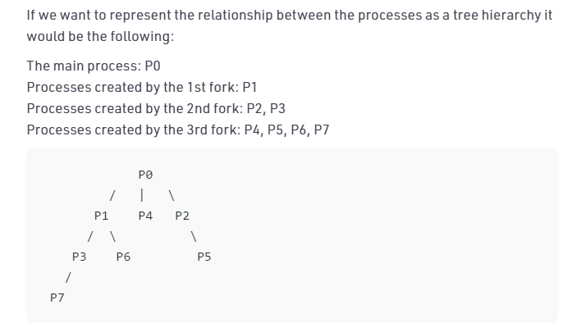
fork()
Output:
hello
hello
hello
hello
hello
hello
hello
hello
here n = 3, 2³ = 8
#include <stdio.h>
#include <sys/types.h>
int main()
{
fork();
fork();
fork();
printf("hello\n");
return 0;
}

Slide 40
fork()
void forkexample()
{ if (fork() == 0)
printf("Hello from Child!\n");
else
printf("Hello from Parent!\n");
}
int main()
{
forkexample();
return 0;
}

Slide 41
fork()
void forkexample()
{ if (fork() == 0)
printf("Hello from Child!\n");
else
printf("Hello from Parent!\n");
}
int main()
{
forkexample();
return 0;
}
Hello from Child!
Hello from Parent!
(or)
Hello from Parent!
Hello from Child!
.
Here, two outputs are possible because the parent process and child process are running concurrently. So we don’t know whether the OS will first give control to the parent process or the child process.

Slide 42
fork()
void forkexample()
{ int x = 1;
if (fork() == 0)
printf("Child has x = %d\n", ++x);
else
printf("Parent has x = %d\n", --x);
}
int main()
{ forkexample();
return 0;
}

Slide 43
fork()
void forkexample()
{ int x = 1;
if (fork() == 0)
printf("Child has x = %d\n", ++x);
else
printf("Parent has x = %d\n", --x);
}
int main()
{ forkexample();
return 0;
}
Parent has x = 0
Child has x = 2
(or)
Child has x = 2
Parent has x = 0
Here, variable change in one process does not
affect other process because data/state of
two processes are different. And also parent and
child run simultaneously, so two outputs are possible.

Slide 44
Inter-process communication (IPC)
Processes executing concurrently in the operating system may be either independent processes or cooperating processes.
A process is independent if it cannot affect or be affected by the other processes executing in the system. Any process that does not share data with any other process is independent.
A process is cooperating if it can affect or be affected by the other processes executing in the system. Any process that shares data with other processes is a cooperating process.

Slide 45
Reasons for providing an environment that allows process cooperation
Information sharing
Several users may be interested in the same piece of information (for instance, a shared file), we must provide an environment to allow concurrent access to such information.
•Computation speedup
If we want a particular task to run faster, we must break it into subtasks, each of which will be executing in parallel with the others. Such a speedup can be achieved only if the computer has multiple processing cores.
•Modularity
We may want to construct the system in a modular fashion, dividing the system functions into separate processes or threads
•Convenience
Even an individual user may work on many tasks at the same time. For instance, a user may be editing, listening to music, and compiling in parallel.

Slide 46
IPC for Cooperating processes
Cooperating processes require an interprocess communication(IPC) mechanism that will allow them to exchange data and information.
Two fundamental models of interprocess communication are
shared memory
message passing

Slide 47
Shared Memory
- In the shared memory model a region of memory that is shared by cooperating processes is established.
- Processes can then exchange information by reading and writing data to the shared region
- Shared memory can be faster than message passing, since message-passing systems are typically implemented using system calls

Slide 48
Message Passing
In the message passing model, communication takes place by means of messages exchanged between the cooperating processes
Message passing is useful for exchanging smaller amounts of data, because no conflicts need be avoided.
Message passing is also easier to implement in a distributed system than shared memory.(Although there are systems that provide distributed shared memory, we do not consider them in this text.)

Slide 49
Inter-process communication (IPC)
There are several mechanisms for Inter-Process Communication (IPC)
Signals
FIFOS (named pipes)
Pipes
Sockets
Message passing
Shared memory
Semaphores

Slide 50
Programming with pipes
Within programs a pipe is created using a system call named pipe.
This system call would create a pipe for one-way communication.
This call would return zero on success and -1 in case of failure.
If successful, this call returns two files descriptors:
Usage
#include <unistd.h>
int pipe(int filedes[2]);

Slide 51
Programming with pipes
Usage
#include <unistd.h>
int pipe(int filedes[2]);
filesdes is a two-integer array that will hold the file descriptors that will identify the pipe If successful,
filedes[0] will be open for reading from the pipe and
filedes[1] will be open for writing down it.
pipe can fail (returns -1) if it cannot obtain the file descriptors (exceeds user-limit or kernel-limit).

Slide 52
Programming with pipes
Here's an extremely important point: a read from a pipe only gives end-of-file if all file descriptors for the write end of the pipe have been closed.
Thus, after a fork, whichever process is intending to do the reading (and thus not the writing) had best close the write end of the pipe.
The above system call closing already opened file descriptor. This implies the file is no longer in use and resources associated can be reused by any other process.
#include<unistd.h>
close(filedes)

Slide 53
Programming with pipes
write(filedes[1], string, MAX);
The above system call is to write to the specified file with arguments of the file descriptor fd, string and the size of buffer.
The file descriptor id is to identify the respective file, which is returned after calling pipe() system call.
The file needs to be opened before writing to the file. It automatically opens in case of calling pipe() system call.
This call would return the number of bytes written (or zero in case nothing is written) on success and -1 in case of failure. Proper error number is set in case of failure.

Slide 54
Programming with pipes
read(filedes[0], line, MAX);
The above system call is to read from the specified file with arguments of file descriptor fd, string and the size of buffer.

Slide 55
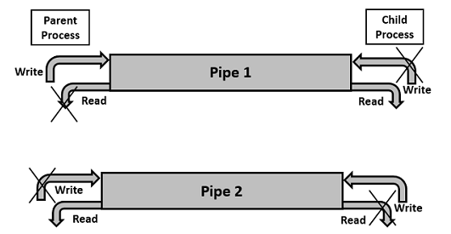
Two-way Communication Using Pipes
Pipe communication is viewed as only one-way communication i.e., either the parent process writes and the child process reads or vice-versa but not both.
However, what if both the parent and the child needs to write and read from the pipes simultaneously, the solution is a two-way communication using pipes. Two pipes are required to establish two-way communication.

Slide 56
Lab Assignment Title: Process Management (Inter-process Communication)
Problem statement:
Write a program to Implement Pipe and / Shared Memory Concept.
Algorithm
Create pipe using pipe system call in parent process.
Create a child process using fork, which returns zero to child process and some nonzero positive integer to the parent process.
Writes the message and transfer them through pipe in Parent process.
Receive the message and read the message in Child process.
Print the same message on the console.
Use wait system call to collect the exit status of child process in parent process.
Terminate the parent process.

Slide 57
if(pid>0)
{
close(filedes[0]);
write(filedes[1],string,MAX);
}
if(pid==0)
{
close(filedes[1]);
n=read(filedes[0],line,MAX);
line[n]='\0';
printf("\n\n Data read by child is : %s",line);
}
exit(0);
}
#include<stdio.h>
#include<sys/types.h>
#include<sys/ipc.h>
#include<unistd.h>
#define MAX 20
int main()
{
int filedes[2],n;
char string[MAX];
char line[MAX];
pid_t pid;
if((pipe(filedes))<0)
{
printf("\n pipe creation error");
exit(0);
}

Slide 58
#include<stdio.h>
#include<sys/types.h>
#include<sys/ipc.h>
#include<unistd.h>
#define MAX 20
int main()
{
int filedes[2],n;
char string[MAX];
char line[MAX];
pid_t pid;
printf("enter the string to be given to the parent");
fflush(stdin);
scanf("%s",string);
if((pipe(filedes))<0)
{
printf("\n pipe creation error");
exit(0);
}
if((pid=fork())<0)
{
printf("\n fork error");
exit(0);
}
if(pid>0)
{
close(filedes[0]);
write(filedes[1],string,MAX);
}
if(pid==0)
{
close(filedes[1]);
n=read(filedes[0],line,MAX);
line[n]='\0';
printf("\n\n Data read by child is : %s",line);
}
exit(0);
}

Slide 59
Process Management-- Threads
A thread is a part of a program.
It is an execution unit within a process
All threads of the same process share the same address space.
All Threads have separate stacks and individual Thread IDs
Thread is a lightweight process because :The context switching between threads is inexpensive in terms of memory and resources.

Slide 60
Process Management-- Threads
Multithreading: Ability of an OS to support multiple, concurrent paths of execution within a single process.
It is also described as the interleaved execution of threads.

Slide 61

Process Management– Differences between threads and processes
Process | Threads
A process is a program in execution | A thread is a part of the process
A process has its own Process ID | A thread has its own thread ID
Every process has its own memory space | Threads use the memory of the process they belong to
Inter process communication is slow as processes have different memory address | Inter thread communication for threads within the same process is fast
The context switching is more expensive in terms of memory and resources. | The context switching is less expensive in terms of memory and resources . Majorly because threads of the same process share the same memory space.

Slide 62
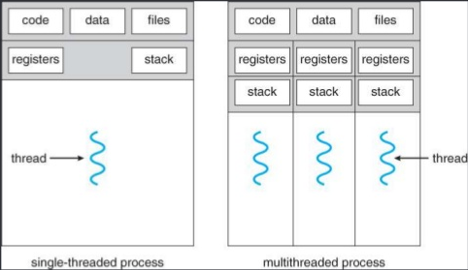
Process Management- --- Threads, a diagrammatic representation

Slide 63
Threads and processes diagrammatic representation
Process Management
One process
one thread
One Process
Multiple threads
Multiple Processes
one thread per process
Multiple Processes
Multiple thread per process

Slide 64
Multithreading
Operating system supports multiple threads of execution within a single process
Examples:
MS-DOS supports a single thread
UNIX supports multiple user processes but only supports one thread per process
Java run time environment supports one process with multiple threads
Windows, Solaris, Linux, Mach, and OS/2 support multiple threads

Slide 65
Thread basics
Thread operations include thread creation, termination, synchronization (join, blocking), scheduling, etc.
All threads within a process share the same address space.
Threads in the same process share:
Process instructions
Data
open files (descriptors)
signals
current working directory
User and group id
Each thread has a unique:
Thread ID
set of registers
stack for local variables, return addresses
priority

Slide 66
Various States of a Thread
Like processes, threads go through several states:
New – Thread is being created.
Ready – Thread is ready to run and waiting for CPU.
Running – Thread is being executed.
Waiting/Blocked – Thread is waiting for an event or resource.
Terminated – Thread has completed execution.

Slide 67
Benefits of Threads
Improved performance on multi-core processors.
Faster context switching than full processes.
Resource sharing: threads of a process share memory and data.
Responsiveness: a multithreaded application remains responsive (e.g., UI thread + background thread).
Better resource utilization.

Slide 68
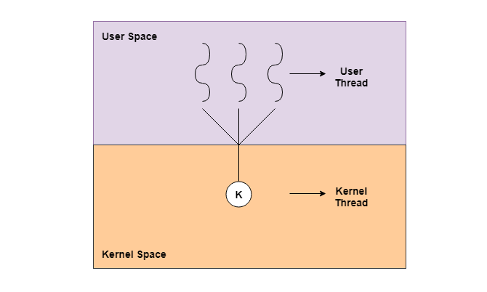
Types of Threads
There are majorly two types of threads :-
1. kernel level threads
2. User level threads

Slide 69
User - Level Threads
User-level threads are implemented by users and the kernel is not aware of the existence of these threads
Kernel handles them as if they were single-threaded processes.
User-level threads are much faster than kernel level threads.
They are represented by a program counter(PC), stack, registers and a small process control block.
Also, there is no kernel involvement in synchronization for user-level threads.
User-Level threads are managed entirely by the user-level library

Slide 70
User-Level Threads
Advantages of User-Level Threads
User-level threads are easier and faster to create than kernel-level threads. They can also be more easily managed.
User-level threads can be run on any operating system.
There are no kernel mode privileges required for thread switching in user-level threads.
Disadvantages of User-Level Threads
Multithreaded applications in user-level threads cannot use multiprocessing to their advantage.
Entire process is blocked if one user-level thread performs blocking operation.

Slide 71
Kernel-Level Threads
Kernel-level threads are handled by the operating system directly and the thread management is done by the kernel
Context information for the process as well as the process threads is all managed by the kernel.
Because of this, kernel-level threads are slower than user-level threads.

Slide 72
Kernel-Level Threads
Advantages of Kernel-Level Threads
Multiple threads of the same process can be scheduled on different processors in kernel-level threads.
The kernel routines can also be multithreaded.
If a kernel-level thread is blocked, another thread of the same process can be scheduled by the kernel.
Disadvantages of Kernel-Level Threads
A mode switch to kernel mode is required to transfer control from one thread to another in a process.
Kernel-level threads are slower to create as well as manage as compared to user-level threads.

Slide 73
POSIX (Portable Operating System Interface Standard) thread functions
pthread_create() 🡪 Creates a new thread
pthread_exit() 🡪 terminates the calling thread
pthread_join 🡪 suspend execution of the calling thread until the target thread terminates
pthread_self() function returns the ID of the calling thread
pthread_detach() function marks the thread identified by thread as detached

Slide 74
Process Scheduling:
Process Scheduling:
Foundation and Scheduling objectives, Types of Schedulers, Scheduling criteria:
CPU utilization, Throughput, Turnaround Time, Waiting Time, Response Time. Scheduling
Algorithms: Pre-emptive and non-pre-emptive, FCFS, SIF, RR.

Slide 75
Process Scheduling:
Scheduling
Scheduling is the process of determining the order in which tasks, processes, or jobs are executed and how resources are allocated among them. This is crucial in various fields, from manufacturing and project management to computer operating systems.

Slide 76
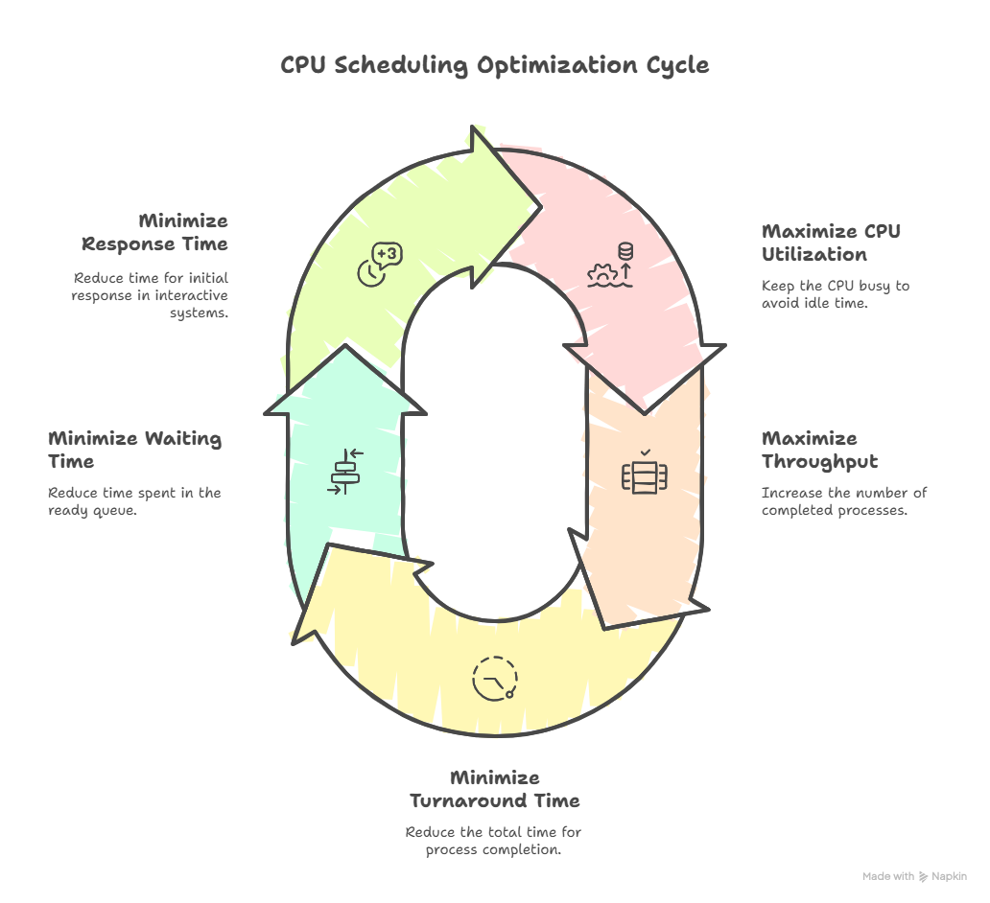
Process Scheduling:

Slide 77
Process Scheduling:
scheduling is essential because:
Resource Management: It allows multiple programs or users to share limited system resources (like the CPU, memory, and I/O devices) effectively.
Multiprogramming/Multitasking: It creates the illusion that multiple tasks are running simultaneously, even on a single CPU, by rapidly switching between them (context switching).
Efficiency: It aims to keep system resources busy and productive.
Responsiveness: For interactive systems, it's vital to provide quick feedback to users.

Slide 78
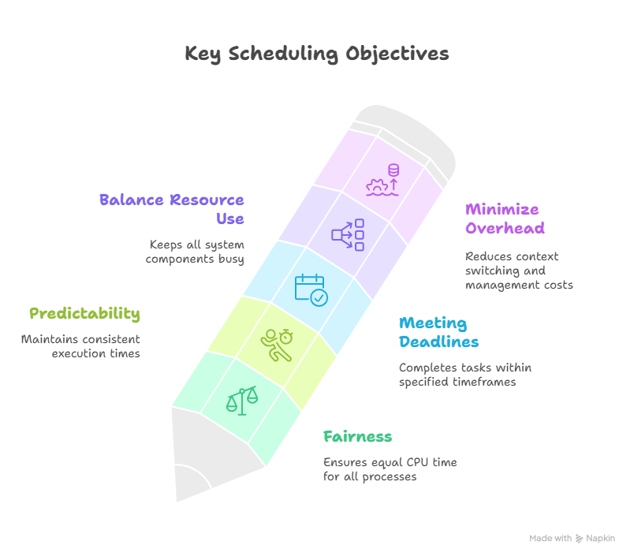
Process Scheduling:

Slide 79
Process Scheduling:
scheduling is essential because:
Minimize Overhead: Reduce the overhead associated with context switching and managing the scheduling process itself.
Balance Resource Use: Keep all parts of the system busy. For example, processes that are I/O-bound should not hold the CPU unnecessarily while I/O devices are idle.
Meeting Deadlines (especially in Real-time Systems): In real-time operating systems (RTOS), it's critical to ensure that processes complete their execution within specified deadlines to maintain system stability and correctness.
Predictability: For a given process, ensure it runs in approximately the same amount of time under similar system loads.
Fairness: Ensure that each process gets a fair share of the CPU time and resources, preventing any process from being indefinitely postponed (starvation).

Slide 80
Process Scheduling:
Schedulers are specialized components that manage how processes are selected and executed by the CPU.
three main types of schedulers:
1.Long-Term Scheduler (Job Scheduler or Admission Scheduler)
2.Short-Term Scheduler (CPU Scheduler or Dispatcher)
3.Medium-Term Scheduler (Swapper)

Slide 81
Scheduler
CPU scheduling decisions may take place when a process:
1.Switches from running to waiting state
2.Switches from running to ready state
3.Switches from waiting to ready state
4.Terminates
Scheduling under 1 and 4 is non-preemptive
All other scheduling is preemptive

Slide 82
Types of process schedulers / Scheduling categories
New
Long term
scheduling
Long term
scheduling
Suspended
Ready
Running
Terminated
short term
scheduling
medium term
scheduling

Slide 83
Process Scheduler:
1.Long-Term Scheduler (Job Scheduler or Admission Scheduler)
• Function: Controls which processes are admitted into the system for execution.
• Role: Moves processes from the job queue (on disk) to the ready queue (in memory).
• Goal: Maintains a balance between I/O-bound and CPU-bound processes to optimize system performance.
• Speed: Slowest among all schedulers.
• Presence: Often absent in time-sharing systems like Windows.

Slide 84
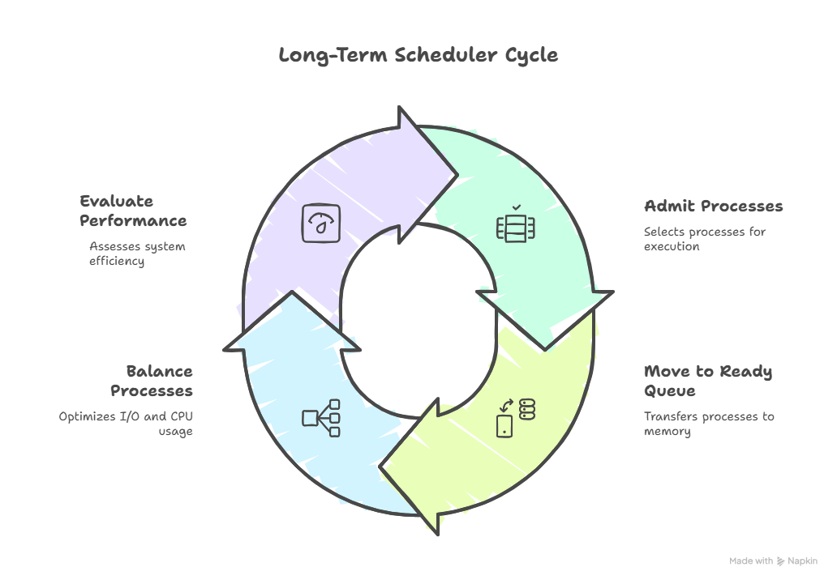
Long-Term Scheduler (Job Scheduler or Admission Scheduler)

Slide 85
Process Scheduler:
2. Short-Term Scheduler (CPU Scheduler)
• Function: Selects a process from the ready queue to execute on the CPU.
• Role: Works closely with the dispatcher to perform context switching.
• Goal: Maximizes CPU utilization and responsiveness.
• Speed: Fastest scheduler; runs frequently (milliseconds).
• Algorithms Used: FCFS, Round Robin, Priority Scheduling, etc.

Slide 86
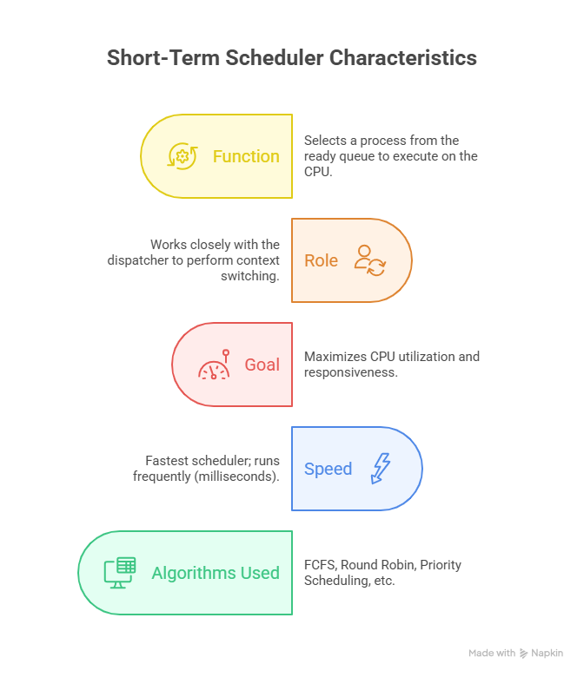
Short-Term Scheduler (CPU Scheduler)

Slide 87
Process Scheduler:
3. Medium-Term Scheduler (Swapper)
Function: Temporarily removes (swaps out) processes from memory to reduce load.
Role: Suspends processes that are waiting (e.g., for I/O) and resumes them later.
Goal: Optimizes memory usage and maintains a good mix of active processes.
Speed: Intermediate—slower than short-term, faster than long-term.
Presence: Common in systems that support swapping and virtual memory.

Slide 88
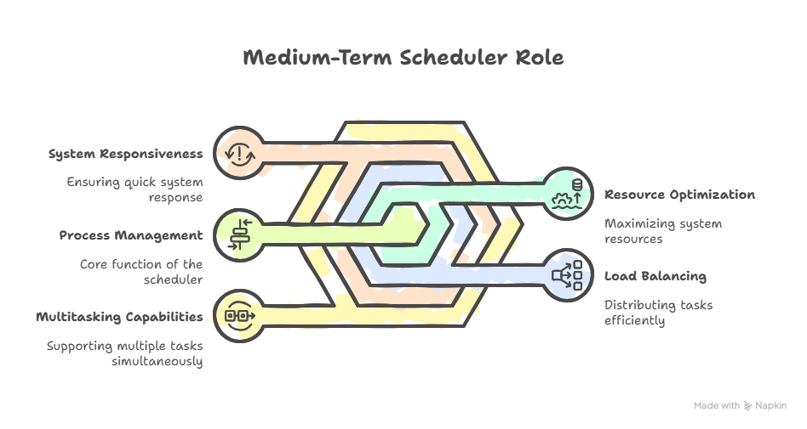
Medium-Term Scheduler (Swapper)

Slide 89
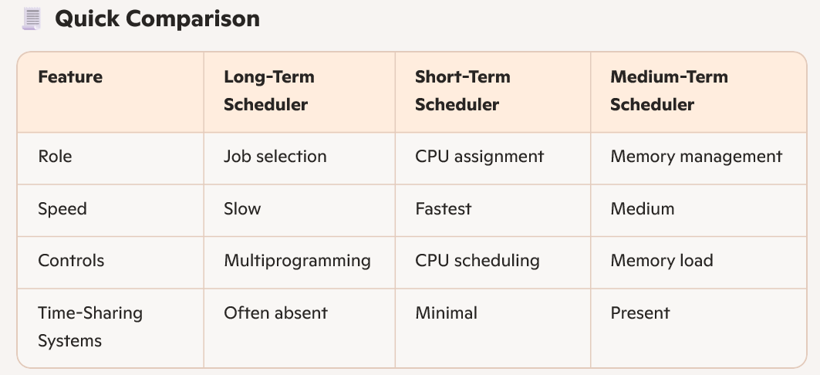
compare Scheduler

Slide 90
What Are Scheduling Criteria?
Scheduling criteria are the benchmarks that help determine how well a scheduling algorithm performs. Since the CPU can execute only one process at a time, the operating system must decide which process to run next.
These decisions are guided by specific goals—like speed, fairness, and responsiveness.

Slide 91
What Are Scheduling Criteria?
Scheduling criteria are the benchmarks that help determine how well a scheduling algorithm performs. Since the CPU can execute only one process at a time, the operating system must decide which process to run next.
These decisions are guided by specific goals—like speed, fairness, and responsiveness.

Slide 92
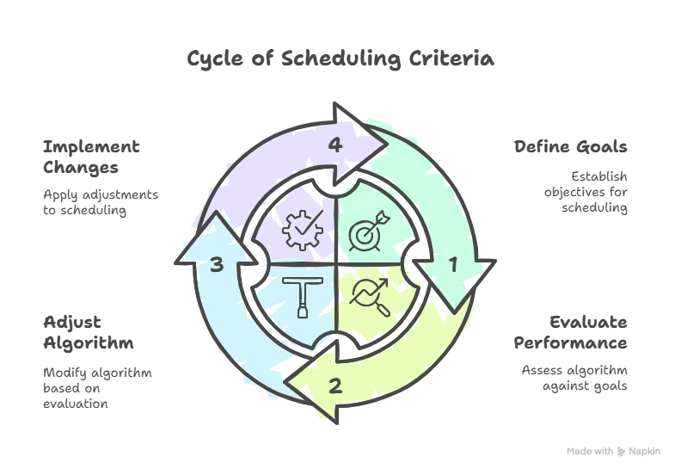

Slide 93
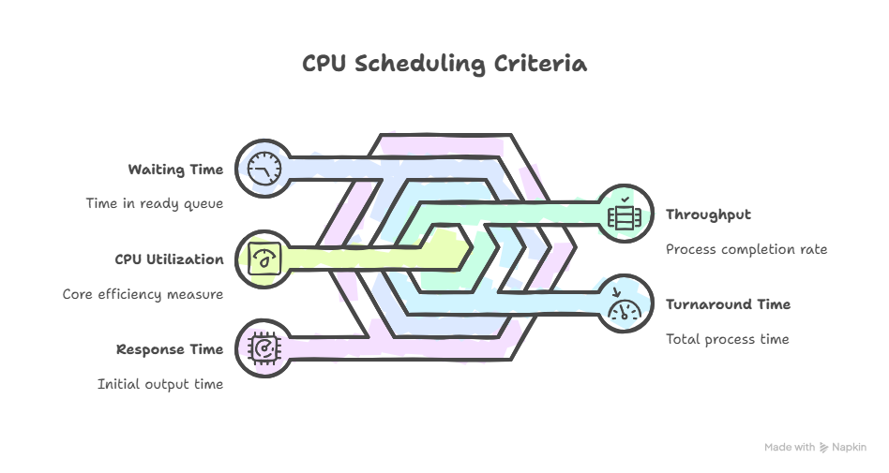

Slide 94
Scheduling Algorithms
They deal with the problem of deciding which of the processes in ready queue is to be allocated the CPU
Algorithm compared based on following criteria
CPU utilization – keep the CPU as busy as possible
Throughput – number of processes completed or amount of work done per unit time
Turnaround time – time of submission of a process to the time of completion
Waiting time – amount of time a process has been waiting in the ready queue
Response time – amount of time it takes from when a request was submitted until the first response is produced
*
94

Slide 95
Optimization Criteria
Max CPU utilization
Max throughput
Min turnaround time
Min waiting time
Min response time
*
95

Slide 96
What Are Scheduling Criteria?
CPU Utilization
This refers to how effectively the CPU is being used. Ideally, the CPU should be busy doing useful work as much as possible. If it’s idle too often, system resources are being wasted.
• Goal: Maximize CPU usage.
• Real-world range: Typically between 40% to 90%.
• Why it matters: High utilization means better performance and resource efficiency.

Slide 97
What Are Scheduling Criteria?
Throughput
Throughput is the number of processes completed in a given time frame. It reflects the system’s productivity.
• Goal: Maximize throughput.
• Example: If 10 processes finish in 1 second, throughput is 10 processes/sec.
• Why it matters: Higher throughput means the system is handling more work efficiently.

Slide 98
What Are Scheduling Criteria?
Turnaround Time
This is the total time taken from the moment a process is submitted to the moment it is completed.
• Formula: Turnaround Time = Completion Time – Arrival Time
• Goal: Minimize turnaround time.
• Why it matters: Users care about how long their tasks take from start to finish.

Slide 99
What Are Scheduling Criteria?
Waiting Time
Waiting time is the amount of time a process spends in the ready queue, waiting for CPU allocation.
• Formula: Waiting Time = Turnaround Time – Burst Time
• Goal: Minimize waiting time.
• Why it matters: Long waits can lead to poor user experience and inefficiency.

Slide 100
What Are Scheduling Criteria?
Response Time
This is the time from when a process is submitted until it produces its first output.
• Goal: Minimize response time.
• Why it matters: Crucial for interactive systems like GUIs or real-time applications.

Slide 101
What Are Scheduling Criteria?
Fairness
Fairness ensures that all processes get a reasonable share of CPU time. It prevents starvation, where low-priority processes never get executed.
• Goal: Ensure equitable CPU access.
• Why it matters: Promotes system stability and user trust.

Slide 102
What Are Scheduling Criteria?
Predictability
Predictability means consistent performance under similar conditions. It’s especially important in real-time systems where timing guarantees are critical.
• Goal: Maintain consistent behavior.
• Why it matters: Users and developers rely on predictable execution for planning and debugging.

Slide 103
Scheduling Algorithms
FCFS (First Come First Serve)
SJF (Shortest Job First)
Priority scheduling
Round Robin scheduling

Slide 104
What Are Scheduling Criteria?
How These Criteria Influence Scheduling Algorithms
Different algorithms prioritize different criteria:
FCFS (First Come First Serve): Simple, but poor waiting time and turnaround time.
SJF (Shortest Job First): Excellent turnaround and waiting time, but risks starvation.
Round Robin: Great for fairness and response time, but may increase waiting time.
Priority Scheduling: Optimizes for importance, but can starve low-priority tasks.
Each algorithm is a trade-off. The choice depends on the system’s goals—whether it’s a batch system, real-time system, or interactive environment.

Slide 105
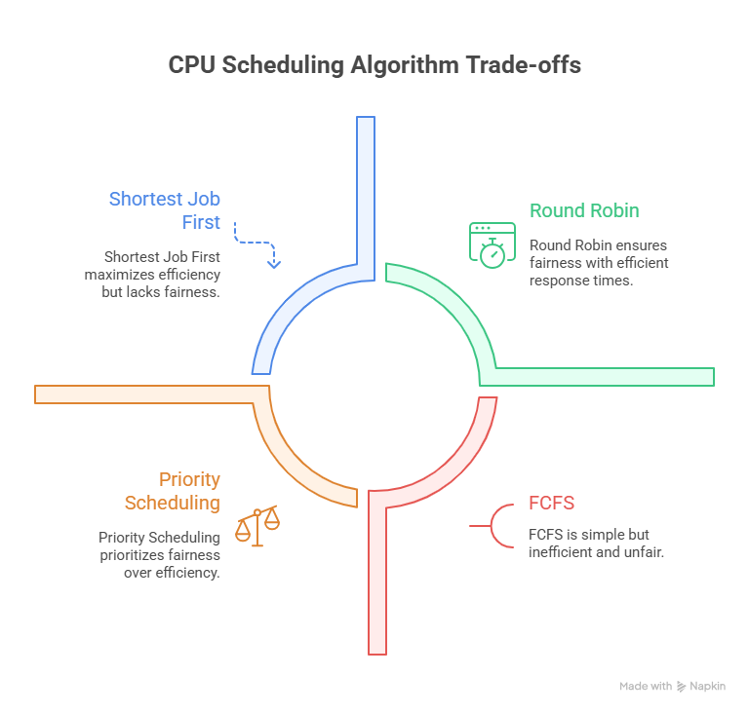

Slide 106
CPU / Process Scheduler
Selects from among the processes in memory that are ready to execute, and allocates the CPU to one of them.
Scheduling may be preemptive or non-preemptive
Non-preemptive – If CPU allocated to a process, it keeps the CPU until it releases it by terminating or switching to waiting state
Preemptive - If CPU allocated to a process, it may be released if high priority process needs the CPU

Slide 107
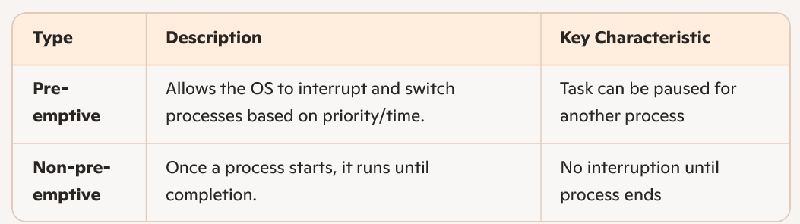
Scheduling Algorithm- Pre-emptive vs Non-pre-emptive

Slide 108
FCFS Scheduling: Characteristics
Selection Function: max(w), selects the process which is waiting in the ready queue for maximum time.
Decision Mode : Non_preemptive
Throughput: Not emphasized
Response Time: May be high, especially if there is a large variance in the process execution times.
Overhead: Minimum
Effect on Processes: Penalizes short processes
Starvation: No

Slide 109
Completion Time
Time at which process completes its execution.
Turn Around Time
Time Difference between completion time and arrival time.
Turn Around Time = Completion Time – Arrival Time
Waiting Time(W.T)
Time Difference between turn around time and burst time.
Waiting Time = Turn Around Time – Burst Time

Slide 110
Process Burst Time
P1 24
P2 3
P3 3
Suppose that the processes arrive in the order: P1 , P2 , P3

Slide 111
The Gantt Chart for the schedule is:
P₁
P₂
P₃
0
24
27
30

Slide 112
The Gantt Chart for the schedule is:
P₁
P₂
P₃
0
24
27
30
Waiting time for P1 = 0; P2 = 24; P3 = 27
Average waiting time: (0 + 24 + 27)/3 = 17
Turnaround time for P1 = 24; P2 = 27; P3 = 30
Average turnaround time : (24 + 27 + 30)/3 = 27

Slide 113
FCFS Scheduling (Cont.)
Suppose that the processes arrive in the order : P2 , P3 , P1
P₂
P₃
P₁
0
3
6
30

Slide 114
FCFS Scheduling (Cont.)
Suppose that the processes arrive in the order : P2 , P3 , P1
P₂
P₃
P₁
0
3
6
30
Waiting time for P1 = 6; P2 = 0; P3 = 3
Average waiting time: (6 + 0 + 3)/3 = 3
Turnaround time for P1 = 30; P2 = 3; P3 = 6
Average turnaround time : (30 + 3 + 6)/3 = 13

Slide 115
Example-2 of FCFS
Process Arrival Time Burst Time
P1 0.0 3
P2 2.0 6
P3 4.0 4
P4 6.0 5
P5 8.0 2

Slide 116
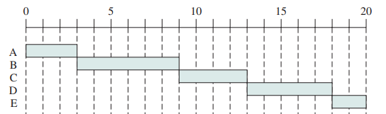
Example-2 of FCFS
Waiting Time Turnaround
Time
0 3
1 7
5 9
7 12
10 12
Avg WT= 23/5=4.6
Avg TAT=8.60
*
116

Slide 117
Example-3 of FCFS
Process Arrival Time Burst Time
P1 0.0 7
P2 2.0 4
P3 4.0 1
P4 5.0 4
P1 P2 P3 P4
0
7
11
12
16
Average waiting time = (0 + 5 + 7 + 7)/4 = 4.75
Average Turnaround Time = (7+9+8+11)/4=8.75
*
117

Slide 118

First Come First Serve (FCFS) ( Non Pre-emptive) Lab implementation
I/P
No of processes
Arrival Time of all processes
Burst time of all processes
O/P
Gantt chart
Completion time/Finish Time
Turnaround time, avg Turnaround time
Waiting time, avg Waiting time
Pseudo code for the algorithm
ST(0)=AT(0)
CT(i)=ST(i)+BT(i)
ST(i+1)=CT(i)
TAT(i)=CT(i)-AT(i)
WT(i)=TAT(i)-BT(i)
118
*
Notes:
118
MIT-WPU

Slide 119
Shortest-Job-First (SJF) Scheduling
Associate with each process the length of its next CPU burst. Use these lengths to schedule the process with the shortest time
Two schemes:
Nonpreemptive – once CPU given to the process it cannot be preempted until completes its CPU burst
Preemptive – If a new process arrives with CPU burst length less than remaining time of current executing process, preempt. This scheme is know as the Shortest-Remaining-Time-First (SRTF)
SJF is optimal – gives minimum average waiting time for a given set of processes

Slide 120
Example of Non-Preemptive SJF
Process Arrival Time Burst Time
P1 0.0 7
P2 2.0 4
P3 4.0 1
P4 5.0 4

Slide 121
Example of Non-Preemptive SJF
Process Arrival Time Burst Time
P1 0.0 7
P2 2.0 4
P3 4.0 1
P4 5.0 4
P₁
P₃
P₂
P₄
0
3
7
8
12
16
Average waiting time = (0 + 6 + 3 + 7)/4 = 4
Average Turnaround Time = (7+10+4+11)/4=8

Slide 122
Non Preemptive SJF Ex2
Process | AT | BT | CT | TAT | WT
P1 | 1 | 7
P2 | 2 | 5
P3 | 3 | 1
P4 | 4 | 2
P5 | 5 | 3
*
122

Slide 123
Non Preemptive SJF Ex2
Process | AT | BT | CT | TAT | WT
P1 | 1 | 7 | 8 | 7 | 0
P2 | 2 | 5 | 19 | 17 | 12
P3 | 3 | 1 | 9 | 6 | 5
P4 | 4 | 2 | 11 | 7 | 5
P5 | 5 | 3 | 14 | 9 | 6
*
123

Slide 124
Shortest Job First Preemptive or Shortest Remaining Time
It is a preemptive version of SJF. In this policy, scheduler always chooses the process that has the shortest expected remaining processing time.
When a new process arrives in the ready queue, it may in fact have a shorter remaining time than the currently running process.
Accordingly, the scheduler may preempt whenever a new process becomes ready.
Scheduler must have an estimate of processing time to perform the selection function.

Slide 125
Shortest Job First Preemptive or Shortest Remaining Time: characteristics
Selection Function: minimum total service time required by the process, minus time spent in execution so far.
Decision Mode : Preemptive ( At arrival time)
Throughput: High
Response Time: Provides good response time
Overhead: Can be high
Effect on Processes: Penalizes long processes.
Starvation: Possible

Slide 126
Example of Preemptive SJF
Process Arrival Time Burst Time
P₁ 0.0 7
P₂ 2.0 4
P₃ 4.0 1
P₄ 5.0 4
P₁
P₂
P₃
P₂
P₄
P₁
0
2
4
5
7
11
16

Slide 127
Example of Preemptive SJF Ex1
Process Arrival Time Burst Time
P₁ 0.0 7
P₂ 2.0 4
P₃ 4.0 1
P₄ 5.0 4
P₁
P₂
P₃
P₂
P₄
P₁
0
2
4
5
7
11
16
Average waiting time = (9 + 1 + 0 +2)/4 = 3
Average turnaround time= (16+5+1+6)/4=7
*
127

Slide 128
Shortest Remaining Time Next (SRTN) ( Pre-emptive)_Example
Process | Arrival Time (T0) | CPU Burst Time (in milliseconds) (Time required for completion ∆T)
P0 | 0 | 10
P1 | 1 | 6
P2 | 3 | 2
P3 | 5 | 4
Gantt Chart
P0
P1
P2
P1
P3
P0
0
1
3
5
9
13
22
Process | Remaining Time
P0 | 9
P2 | 2
P1 | 4
Process | Remaining Time
P0 | 9
P1 | 4
P3 | 4
Initially only process P0 is present and it is allowed to run
But when process P1 comes, it has shortest remaining run time.
So, P0 is pre-empted and P1 is allowed to run.
Whenever new process comes or current process blocks, such type of decision is taken.
This procedure is repeated till all processes complete their execution.
Process | Remaining Time
P1 | 6
P0 | 9
Process | Remaining Time
P0 | 9
P3 | 4
Process | Remaining Time
P0 | 9

Slide 129
Shortest Remaining Time Next (SRTN) ( Pre-emptive)_Example
Output
Process | Arrival Time (T0) | Burst Time (∆T) | Finish Time (T1)
P0 | 0 | 10 | 22
P1 | 1 | 6 | 9
P2 | 3 | 2 | 5
P3 | 5 | 4 | 13
Gantt Chart

Slide 130
Shortest Remaining Time Next (SRTN) ( Pre-emptive)_Example
Output
Process | Arrival Time (T0) | Burst Time (∆T) | Finish Time (T1) | Turnaround Time (TAT = T1 - T0)
P0 | 0 | 10 | 22 | 22
P1 | 1 | 6 | 9 | 8
P2 | 3 | 2 | 5 | 2
P3 | 5 | 4 | 13 | 8
Gantt Chart
Average Turnaround Time= (22+8+2+8) / 4 = 10 milliseconds

Slide 131
Shortest Remaining Time Next (SRTN) ( Pre-emptive)_Example
Output
Process | Arrival Time (T0) | Burst Time (∆T) | Finish Time (T1) | Turnaround Time (TAT = T1 - T0) | Waiting Time (WT = TAT - ∆T)
P0 | 0 | 10 | 22 | 22 | 12
P1 | 1 | 6 | 9 | 8 | 2
P2 | 3 | 2 | 5 | 2 | 0
P3 | 5 | 4 | 13 | 8 | 4
Gantt Chart
Average Turnaround Time= (22+8+2+8) / 4 = 10 milliseconds
Average Waiting Time = (12+2+0+4) / 4= 4.5 milliseconds

Slide 132
Priority scheduling
A priority number (integer) is associated with each process
The CPU is allocated to the process with the highest priority (smallest integer ≡ highest priority)
Preemptive
Nonpreemptive
SJF is a priority scheduling where priority is the predicted next CPU burst time
Problem ≡ Starvation – low priority processes may never execute
Solution ≡ Aging – as time progresses increase the priority of the process

Slide 133
Priority Scheduling-Non Preemptive
Process | AT | BT | Priority | CT | TAT | WT
P1 | 0 | 11 | 2
P2 | 5 | 28 | 0
P3 | 12 | 2 | 3
P4 | 2 | 10 | 1
P5 | 9 | 16 | 4
*
133

Slide 134
Priority Scheduling-Non Preemptive
Process | AT | BT | Priority | CT | TAT | WT
P1 | 0 | 11 | 2 | 11 | 11 | 0
P2 | 5 | 28 | 0 | 39 | 34 | 6
P3 | 12 | 2 | 3 | 51 | 39 | 37
P4 | 2 | 10 | 1 | 49 | 47 | 37
P5 | 9 | 16 | 4 | 67 | 58 | 42
134

Slide 135
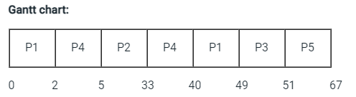
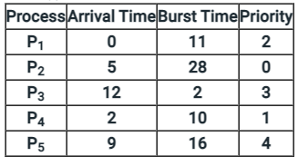
Priority Scheduling-Preemptive
*
135

Slide 136
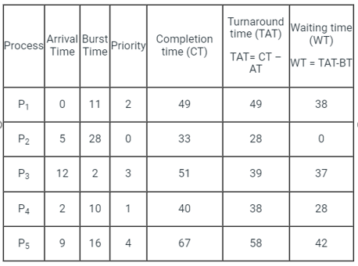
Priority Scheduling-Preemptive
*
136

Slide 137
Round Robin (RR)
Each process gets a small unit of CPU time (time quantum)
After time has elapsed, the process is preempted and added to the end of the ready queue.
If there are n processes in the ready queue and the time quantum is q, then each process gets 1/n of the CPU time in chunks of at most q time units at once.
No process waits more than (n-1)q time units.

Slide 138
RR: characteristics
Selection Function: constant
Decision Mode : Preemptive ( At time quantum)
Throughput: May be low if time quantum is too small
Response Time: Provides good response time for short processes
Overhead: Minimum
Effect on Processes: Fair treatment
Starvation: No

Slide 139
Example of RR with Time Quantum = 20
Process Burst Time
P1 53
P2 17
P3 68
P4 24

Slide 140
Example of RR with Time Quantum = 20
Process Burst Time
P1 53
P2 17
P3 68
P4 24
P₁
P₂
P₃
P₄
P₁
P₃
P₄
P₁
P₃
P₃
0
20
37
57
77
97
117
121
134
154
162
Average waiting time = (81+ 20 + 94+ 97)/4 = 73
Average turnaround time= (134+37+162+121)/4=113.5
Typically, higher average turnaround than SJF, but better response

Slide 141
Example: Round Robin (By Default preemptive: Time Quantum 2)
Process Arrival Time Burst Time
P₁ 0.0 7
P₂ 2.0 4
P₃ 4.0 1
P₄ 5.0 4

Slide 142
Example: Round Robin (By Default preemptive: Time Quantum 2)
Process Arrival Time Burst Time
P₁ 0.0 7
P₂ 2.0 4
P₃ 4.0 1
P₄ 5.0 4
P1
P2
P1
P3
P2
P4
P1
P4
P1
0
2
4
6
7
9
11
13
15
16

Slide 143
Example: Round Robin (By Default preemptive: Time Quantum 2)
Process Arrival Time Burst Time
P₁ 0.0 7
P₂ 2.0 4
P₃ 4.0 1
P₄ 5.0 4
P1
P2
P1
P3
P2
P4
P1
P4
P1
0
2
4
6
7
9
11
13
15
16
Average waiting time = (9 + 3 + 2 +6)/4 =5
Average turnaround time =(16+7+3+10)/4=9

Slide 144
Round Robin Ex 2 (Q=4)
Process | AT | BT | CT | TAT | WT
P1 | 0 | 3
P2 | 2 | 6
P3 | 4 | 4
P4 | 6 | 5
P5 | 8 | 2
*
144

Slide 145
Round Robin Ex 2 (Q=4)
Process | AT | BT | CT | TAT | WT
P1 | 0 | 3 | 3 | 3 | 0
P2 | 2 | 6 | 17 | 15 | 9
P3 | 4 | 4 | 11 | 7 | 3
P4 | 6 | 5 | 20 | 14 | 9
P5 | 8 | 2 | 9 | 11 | 9
*
145

Slide 146
Round Robin Ex 2 (Q=1)
Process | AT | BT | CT | TAT | WT
P1 | 0 | 3
P2 | 2 | 6
P3 | 4 | 4
P4 | 6 | 5
P5 | 8 | 2
*
146

Slide 147
Round Robin Ex 2 (Q=1)
Process | AT | BT | CT | TAT | WT
P1 | 0 | 3 | 4 | 4 | 1
P2 | 2 | 6 | 18 | 16 | 10
P3 | 4 | 4 | 17 | 13 | 9
P4 | 6 | 5 | 20 | 14 | 9
P5 | 8 | 2 | 15 | 7 | 5
*
147

Slide 148
References
1. William Stallings, Operating System: Internals and Design Principles, Prentice Hall, ISBN-10: 0-13-380591-3, ISBN-13: 978-0-13-380591-8, 8th Edition
2. Abraham Silberschatz, Peter Baer Galvin and Greg Gagne, Operating System Concepts, WILEY,ISBN 978-1-118-06333-0, 9th Edition
*
148
21/02/19
Operating system
148
Notes:
148
MIT-WPU

Slide 149
SJF - preemptive
Process | AT | BT | CT | TAT | WT
P1 | 0 | 8
P2 | 1 | 4
P3 | 2 | 2
P4 | 3 | 1
*
149

Slide 150
SJF - preemptive
Process | AT | BT | CT | TAT | WT
P1 | 0 | 8 | 15 | 15 | 7
P2 | 1 | 4 | 7 | 6 | 2
P3 | 2 | 2 | 5 | 3 | 1
P4 | 3 | 1 | 5 | 2 | 1
*
150

Slide 151
FCFS- Non Preemative
Process | AT | BT | CT | TAT | WT
P1 | 0 | 5
P2 | 1 | 3
P3 | 2 | 8
P4 | 3 | 6
*
151

Slide 152
FCFS- Non Preemative
Process | AT | BT | CT | TAT | WT
P1 | 0 | 5 | 5 | 5 | 0
P2 | 1 | 3 | 8 | 7 | 4
P3 | 2 | 8 | 16 | 14 | 6
P4 | 3 | 6 | 22 | `19 | 13
*
152

